Slide 1
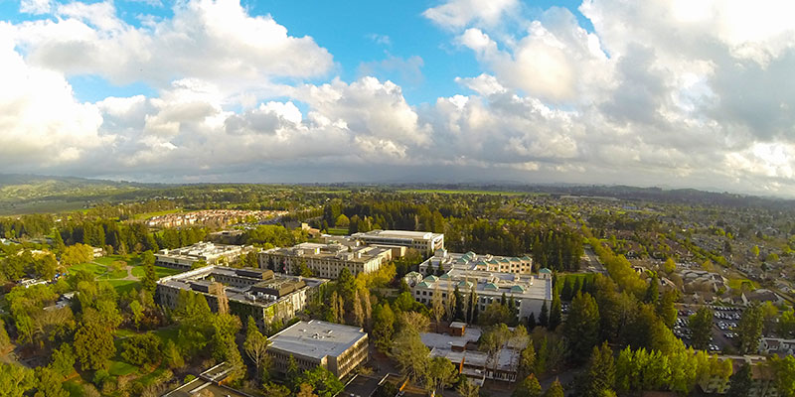

Budget Briefing
Sonoma State University
Academic Senate
August 31st, 2017
University Budget and Planning

Slide 2
2016-2017
Budget Review

Slide 3

University Budget by Division, 2015-16 and 2016-17
Division percentages include benefits
University Wide does not include State University Grants

Slide 4
University Operating Fund
Year End Balances by Division, 2016-17

Slide 5
2017-2018
Proposed Campus Budget

Slide 6
2017-2018 Budget
The Final Budget Memo of July 2017 outlined over $4.8M of new state allocation funding to the campus, in addition to the anticipated increase in student fees. The increase in campus funding is mostly in the areas of mandatory cost increases (employee compensation, benefits and new space) as well as increased financial aid distributions due to the tuition fee increase. Notably, the campus received over $2.1M in Graduation Initiative 2025 funding and $596,000 in enrollment growth funding to serve 56 new full time students (FTES).
Changes in the Operating Fund between 2016-2017 and 2017-2018 are outlined below:
 | 2016-2017 |  | 2017-2018 |  | CHANGE
State Allocation | $ 63,135,883 | 56 % | $ 68,002,883 | 57 % | $ 4,867,000
Tuition and Fees | $ 48,293,928 | 44 % | $ 50,669,084 | 43 % | $ 2,375,156
TOTAL | $ 111,429,811 |  | $ 118,671,967 |  | $ 7,242,156

Slide 7
2017-2018 Budget
Proposed Resource Allocation:
Designated Funds: Employee Salary Increases and Benefits $3,987,000
Graduation Initiative 2025 $2,168,000
Enrollment Growth Funding: Tenure Track Hires – 5 FTEF $ 596,000
Increase to Financial Aid State University Grants $ 605,000
New Space Funds for Wine Spectator Learning Center $ 177,000
Subtotal Allocation $7,533,000
Net Loss Due to Increase in Average Unit Load ($ 290,844)
Total New Funds $7,242,156
Residential Full Time Equivalent Student (FTES) Chancellor’s Office Target for 2017-2018: 8,244

Slide 8
Proposed Operating Budget by Division, 2016-17 and 2017-18
Operating Budget Totals
Total 16-17 $111,429,811
Total 17-18 $118,671,967
*Division totals include benefits
University Wide does not include State University Grants

Slide 9
Proposed Operating Budget by Division, 2016/17 and 2017/18
Division percentages include benefits
University Wide does not include State University Grants

Slide 10
University Budget by Division, 3 Year Comparison
Division percentages include benefits
University Wide does not include State University Grants

