Slide 1
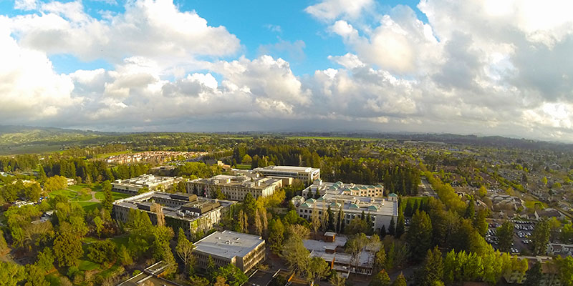
Share.Shape.Unite.
Building our Future @ SSU
Sonoma State University
Academic Senate
May 17, 2018

Slide 2
Process Co-creation & Launch: Fall 2018
After the fires, and in consultation with the Executive Committee of the Senate and with AS senators, we devised guiding principles and composition.
*Co-chairs = Senate Chair & Provost
*Nominations:
  3 faculty (rec. through Ac. Sen. Structure & Functions)
  3 students (rec. through Associated Students)
  3 staff (rec. through HR)
  1 alum / community member
Leap Solutions = consulting support

Slide 3
Taskforce = Keepers of the Process
Senate Chair Works, Co-chair, Faculty*
Provost Vollendorf, Co-chair
Carlos Torres, Anthropology, Faculty*
Laura Krier, Library, Faculty*
Emiliano Ayala, Education, Faculty
Tramaine Austin-Dillon, Residential Life, Staff
Julie Shell, Extended and International Education, Staff
David Crozier, Financial Services, Staff
Madeline Cline, Student*
Aren Ammari, Student*
Alicia Sloper, Student
Anne Benedetti, Alumna
* indicates member of Ac. Senate or AS

Slide 4
Share.Shape.Unite.
Share Phase (December-January)
Launch event
Online survey
Board meetings (Alumni + GMC + SSU Foundation + Wine Business Institute + SSU Entrepreneurial Services)
Shape Phase (January-February)
Department + Unit + Division Strategic Planning Exercise
(All SSU divisions + Associated Students)
World Cafés
Unite Phase (March-April)
Plan drafted + shared for feedback
Progress update event

Slide 5
Inclusive Excellence + Data Democracy
~30,000 people invited to participate
~4,000 responses broken down as follows:
  1,680 faculty and staff (44%)
  1,143 students (30%)
  538 alumni (14%)
  336 people with multiple affiliations (9%)
  30 SSU board members (1%)
  124 community members (3%)
All input was discussed, analyzed, & considered.

Slide 6
Inclusive Excellence + Data Democracy
Regular updates to the ExCom and to Senate were provided by the co-chairs throughout the year
Data posted to website. Data analysis drove the creation of the plan. Internal & external data analysis done (Leap Solutions + Reporting and Analytics at SSU) to cross reference findings.
In April, the draft plan was posted for everyone to give input before being finalized. The April input was critically important for the final plan!

Slide 7

Mission for Strategic Plan 2025
Sonoma State is a regionally serving public university committed to educational access and excellence. Guided by our core values and driven by a commitment to the liberal arts and sciences, Sonoma State delivers high-quality education through innovative programs that leverage the economic, cultural, and natural resources of the North Bay.

Slide 8
Vision for Strategic Plan 2025
Sonoma State University embraces innovation in our quest to be a national model for public higher education by 2025. Our students graduate prepared to meet the challenges of the 21st century and to make an impact in the community and the world.

Slide 9
Core Values
We proudly embrace integrity, respect, excellence, and responsibility as part of our Seawolf Commitment. Our core values include:
Diversity and social justice
Sustainability and environmental inquiry
Connectivity and community engagement
Adaptability and responsiveness

Slide 10
Priority #1
Student Success
Sonoma State aspires to be a national model for student success, which includes all aspects of the student experience, from academics to campus life to graduation. All members of our campus community have the responsibility to serve students with integrity and to provide the support services students need to succeed.

Slide 11
Priority #2
Academic Excellence and Innovation
Sonoma State has high-quality, innovative academic programs that prepare students to flourish in a changing workforce and world. By educating beyond classroom walls and across disciplines, Sonoma State promotes synergy and creativity in a dynamic educational environment that responds to regional workforce and community needs.

Slide 12
Priority #3
Leadership Cultivation
As the region’s only public four-year university, Sonoma State embraces its leadership role in the North Bay and beyond. We prepare the next generation of leaders by providing students with opportunities to learn the knowledge and skills needed to build a better society both locally and globally.

Slide 13
Priority #4
Transformative Impact
Sonoma State transforms the lives of students, families, and communities by providing educational access and opportunity to help all students succeed. Our faculty and staff work to transform our region, our communities, and our academic disciplines through service, research, programming, and outreach.

Slide 14
Building our Future @ SSU: Next Steps
Short term (2018-19)
Training on how to implement the strategic plan
Create division plans + unit plans with goals, strategies, and metrics
Start to align budget to priorities
Creating an assessment plan so we can assess & adapt
Longer term (2019-2025)
Assess & measure our progress
Adapt our goals to a changing context

Slide 15
Building our Future @ SSU: Next Steps
Our plan is our roadmap and our framework for our success over the next few years.
It will guide our strategic budgeting and overall strategic alignment to mission, vision, values, and priorities so we can help SSU be better and stronger for our students, faculty, staff, alumni, and the broader community.

